Slide 1
VOLA
Guide for Using Vola Event Management
and
Timing Software for Season 2021

Slide 2
IMPORTANT SEASON 2021 NOTICE
The COVID-19 pandemic may require ski area management to implement procedures to protect the wellbeing of their employees and guests.
These procedures may:
vary from venue to venue, county to county, state to state
impact event operations and programs
must be relayed to all event officials, Team Captains, and competitors
must – without question – be respected and observed

Slide 3
COVID-19 BEST PRACTICES GUIDELINES
In addition to ski are management procedures, all event operations must follow local health authority guidelines
During the pandemic, U.S. Ski & Snowboard will maintain a COVID-19 resource page with recommended protocols:
usskiandsnowboard.org/covid-19
Alpine Officials’ information is available in a separate education folder entitled:
“COVID-19 Best Practices Guidelines”
Notes:
Documents on the U.S. Ski & Snowboard website are “living documents” and will be updated as COVID-19 protocol changes occur

Slide 4
Race Results Software usskiandsnowboard.org/sport-development/officials-development/timing-race-administration vola.fr/en/timing/logiciels/suite-skialp /skialp-pro

Slide 5
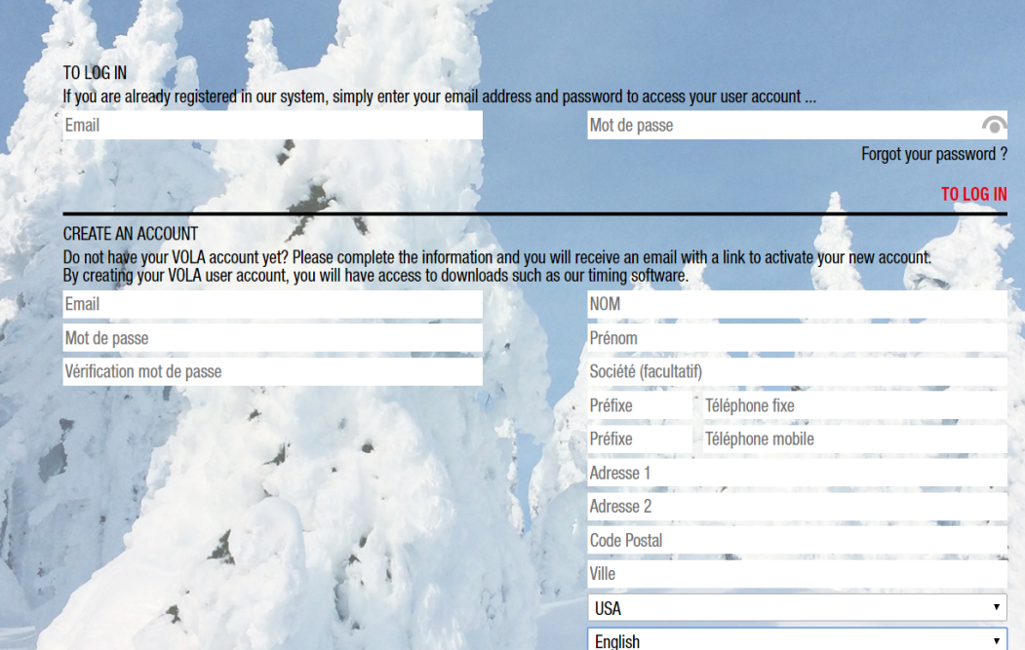
Downloading Vola Ski Alp Pro
Access the Vola Website.
Click on icon
Create your profile and confirm via registration email.
Select Nation/Language
Download will begin of
the .exe file

Slide 6
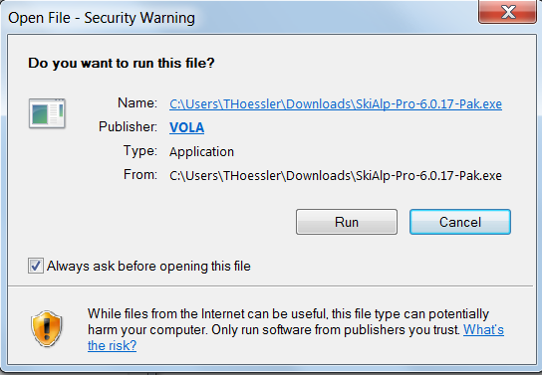
Select ‘Run’
NOTE: You will be asked if you wish to allow this program to make changes to your computer. In order to continue installation, you must answer: YES

Slide 7
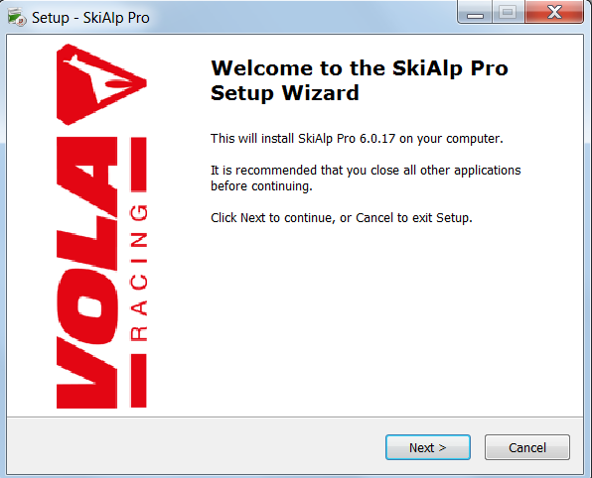
Select ‘Next’ and Begin Installation

Slide 8
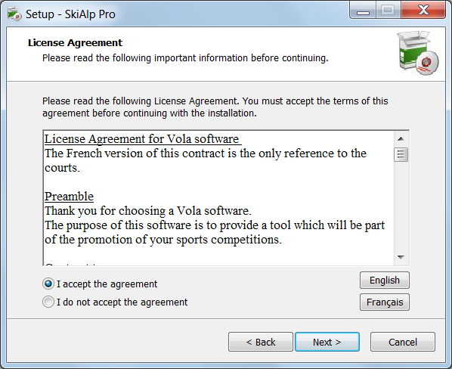
Accept and Select Next

Slide 9
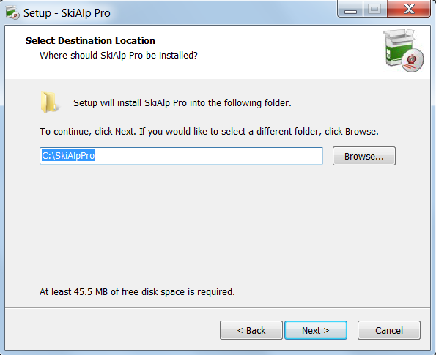
Select Next

Slide 10
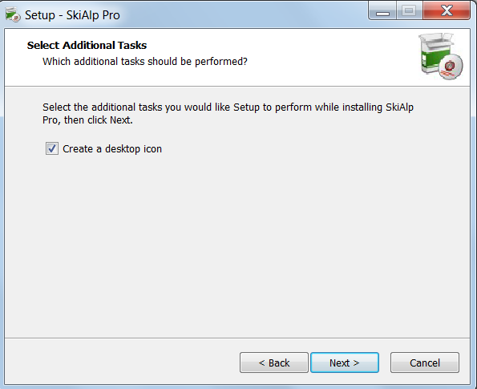
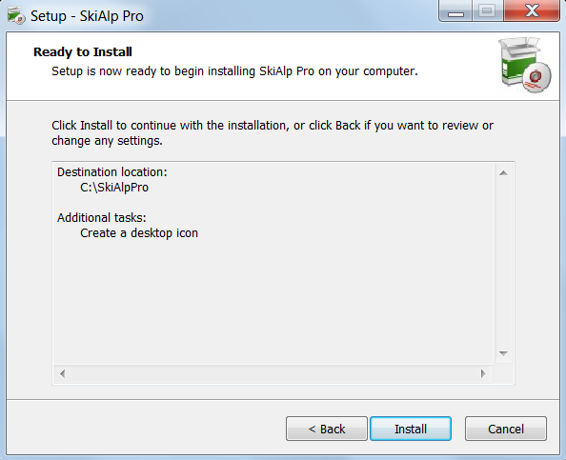
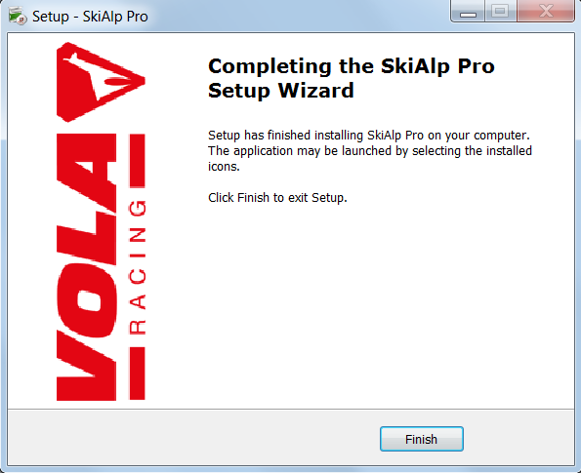
FINAL STEPS:
1. Create Icon/NEXT
2. Verify/INSTALL
3. FINISH
Click on created desktop icon to start the software.

Slide 11
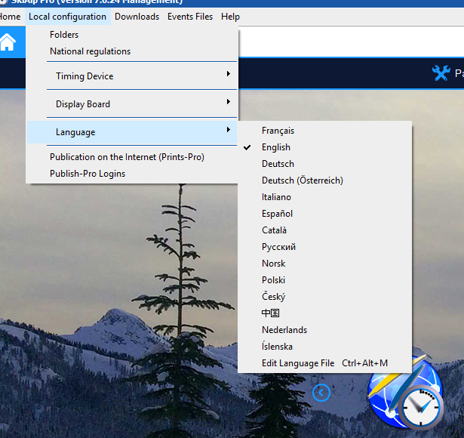
Local Configurations
Choose Local Configurations
Choose National Regulations
Choose Language:
‘English’

Slide 12
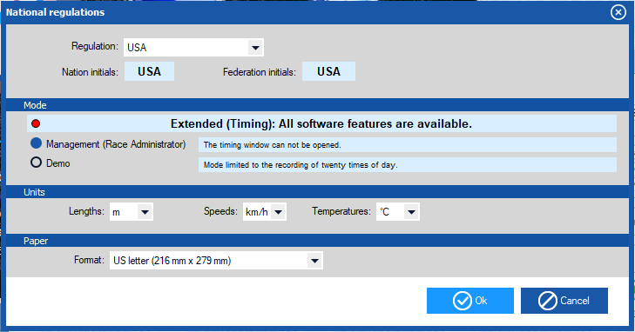
National Regulations
This sets your
- Nation
- Lengths
- Speeds
- Temperature - Management
mode for Race
Administrators

Slide 13
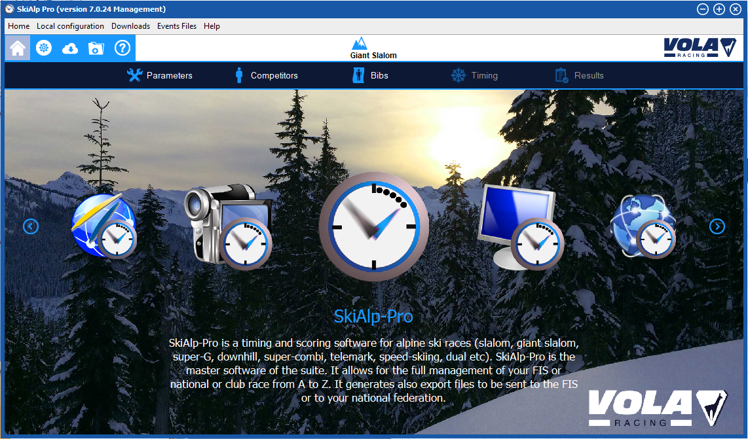
OPENING SCREEN
Time to verify your dongle and create an event.

Slide 14
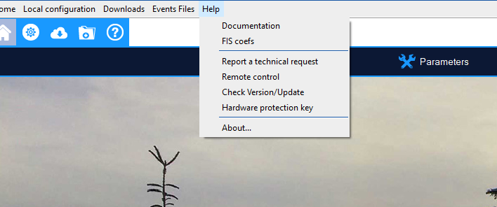
Verify your dongle
Select Help
Choose Hardware Protection Key

Slide 15
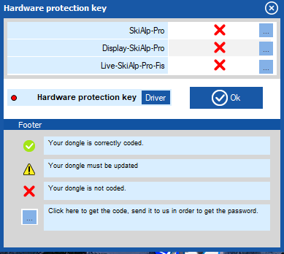
Dongle Driver and Confirmation
Install Driver: Follow the directions carefully
Red confirms the dongle is NOT working properly.

Slide 16
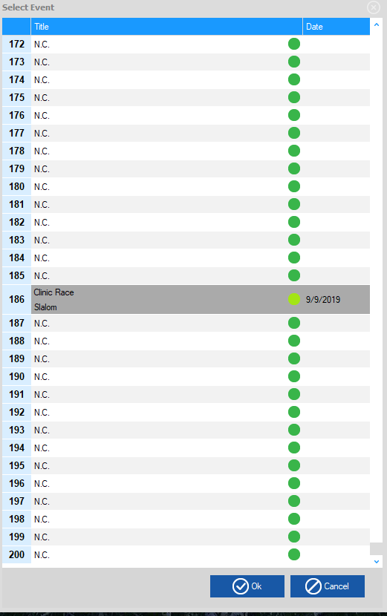
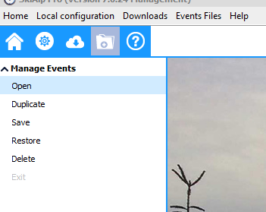
Creating an Event
Click on Folder Icon to open ‘Select Event’ Window.
Choose Manage Events
Choose a previous event or Choose N.C. to create a ‘New Event’
Will hold up to 200 events
NOTE: A ‘dongle’ is not required in order to create or administer an event. It is only required for timing functions.

Slide 17
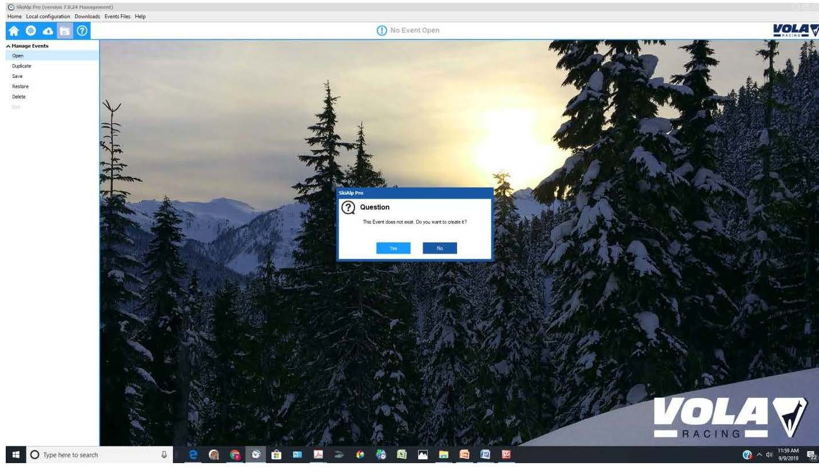
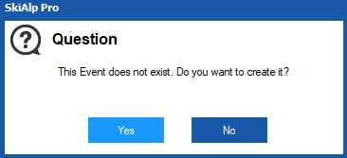
New Event Selected

Slide 18
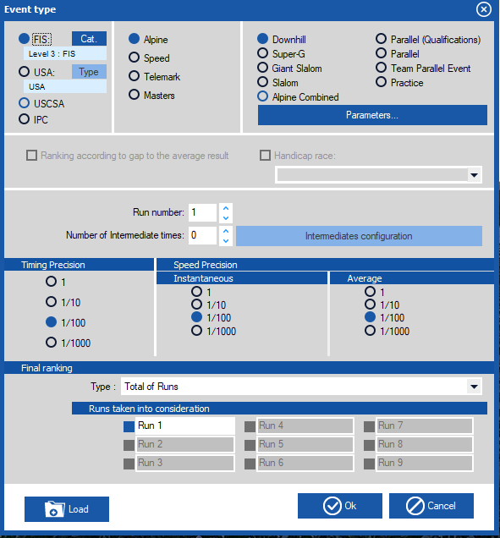
Event Type
Use the radio buttons to complete the data for your event: - U.S. Ski & Snowboard/FIS - Discipline/Event:
DH.SG.GS.SL.AC.PL
- # of intermediate times - # of runs in the event - Timing Precisions as
reported on results

Slide 19
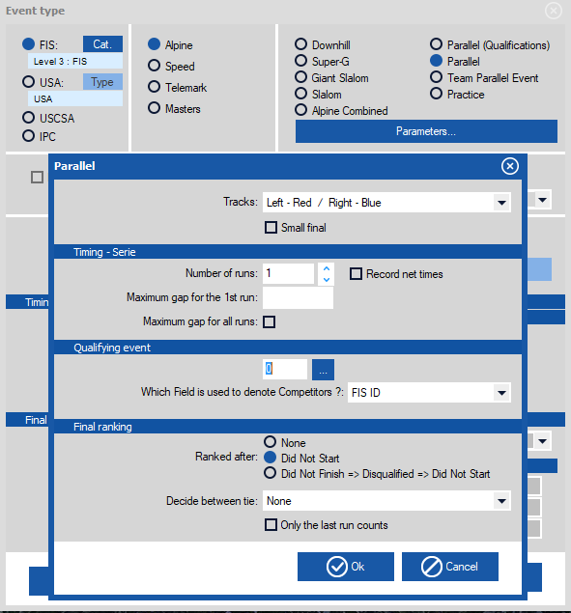
PARALLEL: Set your “Parameters”

Slide 20
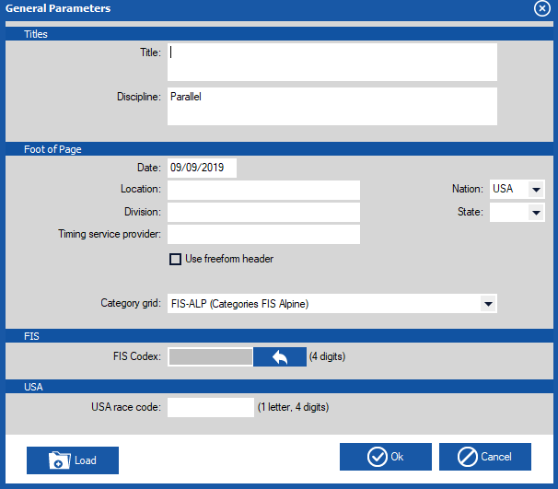
General Parameters
- Event Title
- Discipline/Event
- Date
- Location
- Organization
- Timing

Slide 21
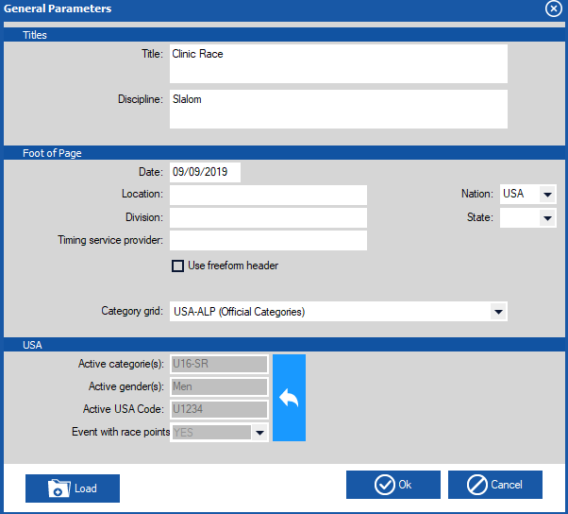
Codex and Gender – U. S. Ski & Snowboard Races
Click on to add gender, age class & codex

Slide 22
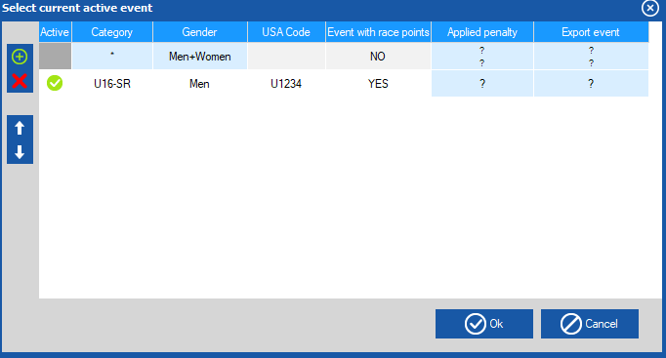
Codex and Gender – U. S. Ski & Snowboard Races
Choose + ,
then double click on Category = Age Class Gender = Men/Women Codex = USA code Event points = yes/no
This example will only show one gender per event file.

Slide 23
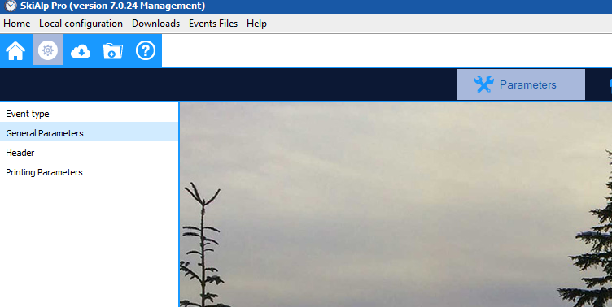
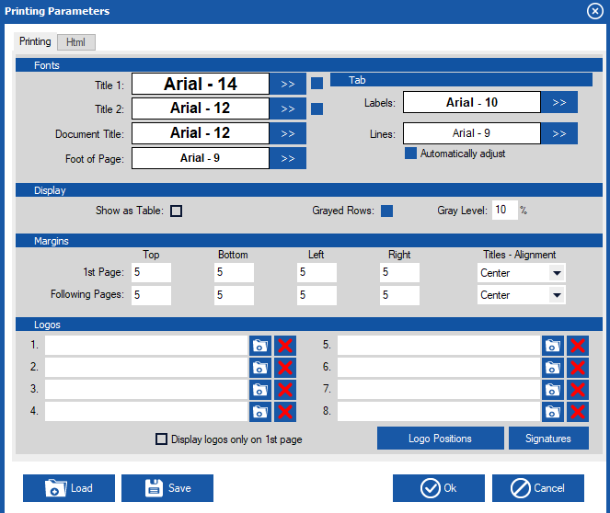
Printing Parameters
OC can choose from different Fonts, Font Size, Logos, Watermarks, General layout Can be saved for future use

Slide 24
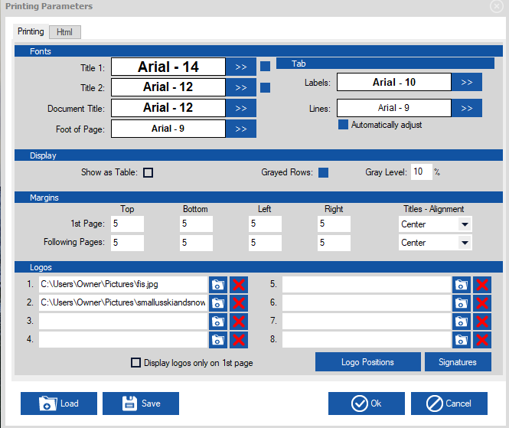
Printing Parameters Adding logos
Logo set ups can be ‘Saved’ to
your ‘config’ folder
Your logo set up can then be loaded into a new event folder
by using the ‘Load’ button.
Logo layout can be accessed by selecting logo positions

Slide 25
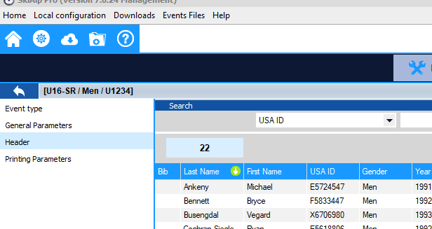
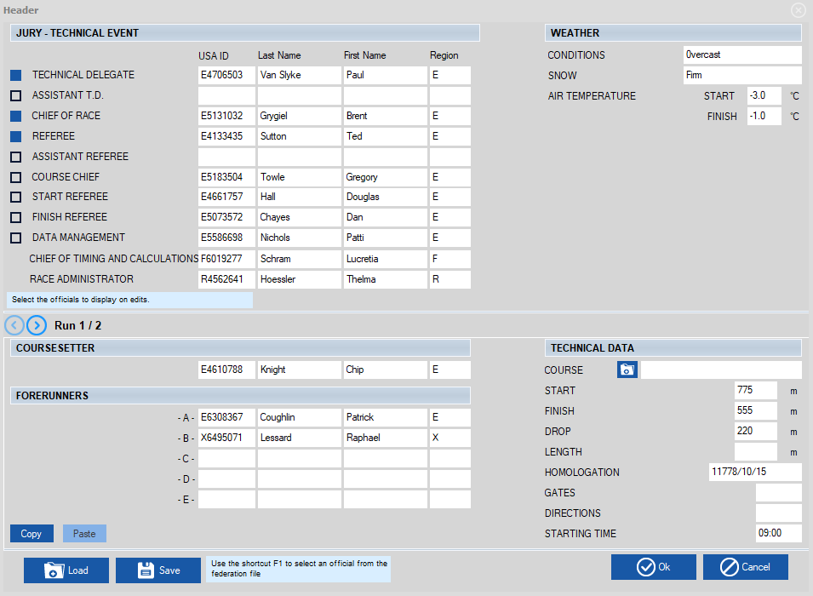
Parameters Header – Officials
Choose the Jury you need printed on results.
Place your cursor in the desired field and choose F1 to pull up valid officials.

Slide 26
Parameters Header Forerunners-Technical Data
Enter Weather Data
Choose the folder next to ‘Course’ to download homologation information
Course Setter and Forerunners can be entered by using F1

Slide 27
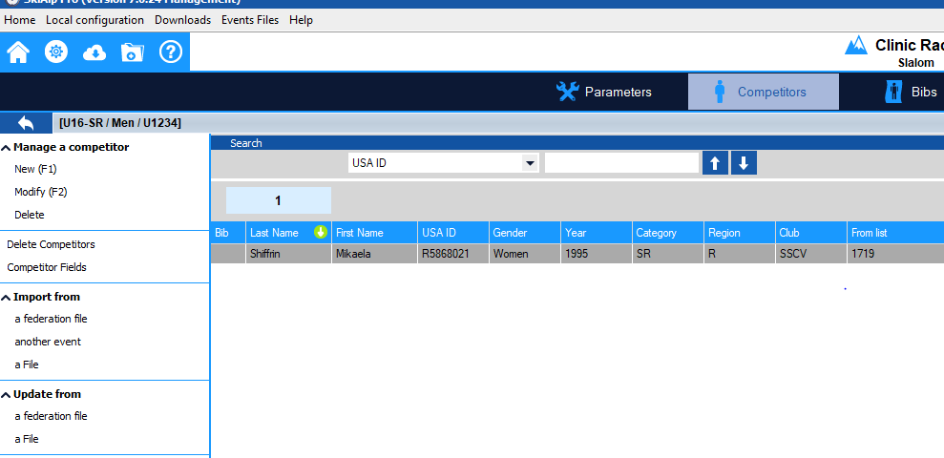
Competitor Page
Select Competitors at top of the page.

Slide 28
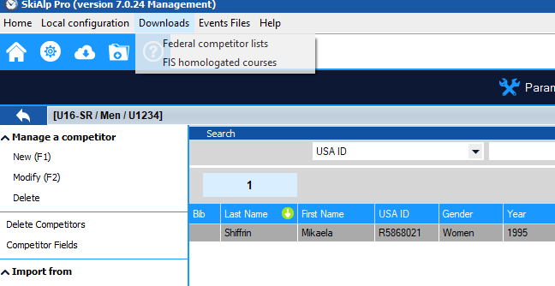
Downloading a Points List
Choose the ‘Downloads’ tab from top and choose ‘Federal competitor lists.’
Choose FIS homologated courses to download a database
of information to use in headers. This only needs to be done once
or twice a season.

Slide 29
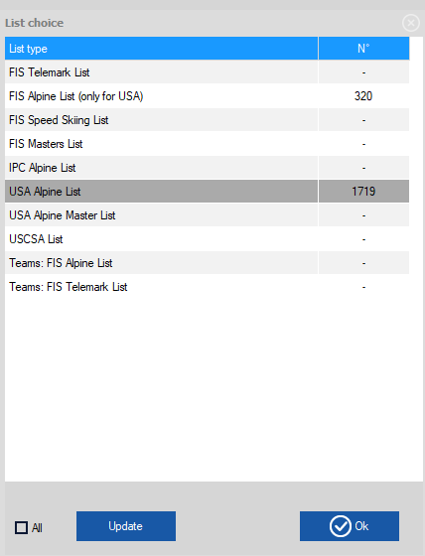
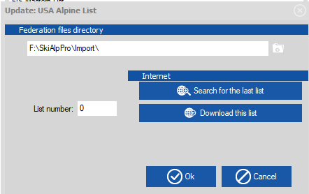
“DOWNLOAD” Points List
Select List
Choose Update
Enter List # or ‘Search for the last list’.
‘Download this list’ followed by Ok to import the list and the athlete list will open.
Complete for U.S. Ski & Snowboard and FIS (alpine for U.S. Ski & Snowboard only)

Slide 30
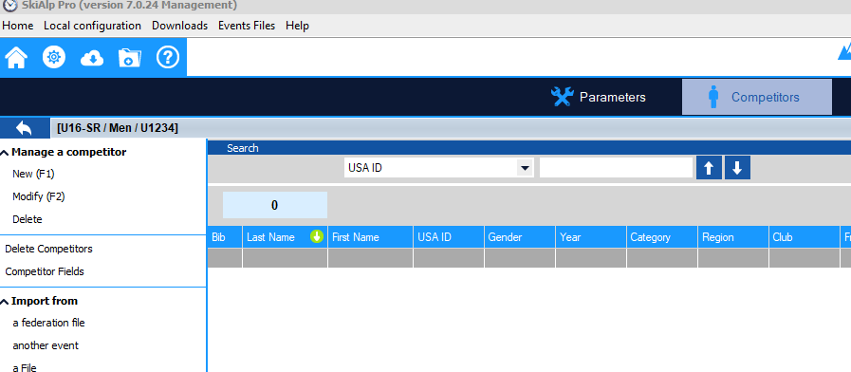
Points List – Entering Individual Athletes
In Competitor screen, select Import from a federation file. Then select the list USA Alpine or FIS

Slide 31
Points List – Entering Individual Athletes
Enter ‘Last Name’ of the athlete.
Once highlighted, double click, or hit F1, to enter athlete into the event file. Filters can be set up to enter blocks of athletes.

Slide 32
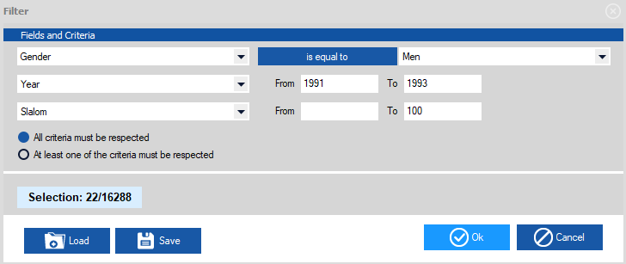
Entering Athletes using Filters
To enter a group of athletes you can apply a filter. Filters are available for: Gender, Year of Birth, Event, Club, Division, Etc. To access the filter screen select the filter box on the points list
In this example: 22 athletes meet the criteria of Men, YOB 91-93 with SL Points between 0 and 100

Slide 33
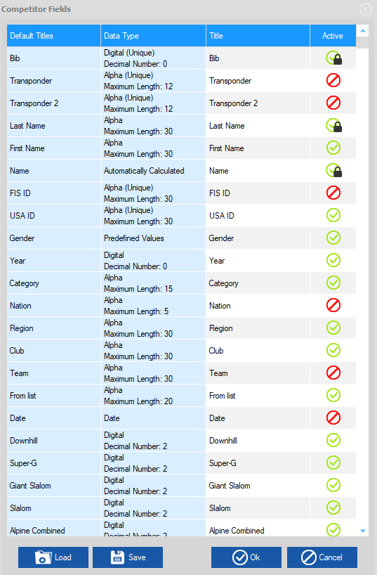
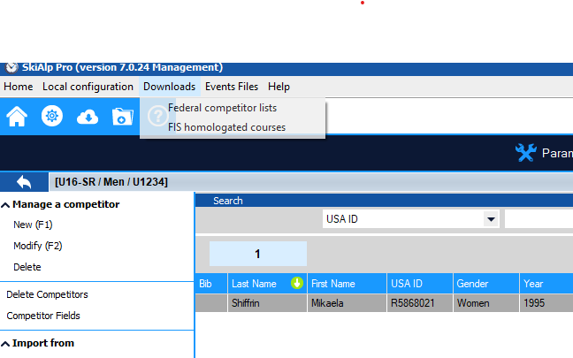
Competitor Fields
Define your competitor fields prior to importing competitors from excel.
Choose: ‘Competitor Fields’
(Make Category active if you want to see age classes.)
Double click to make item active
or inactive, notated by green and red  symbols

Slide 34
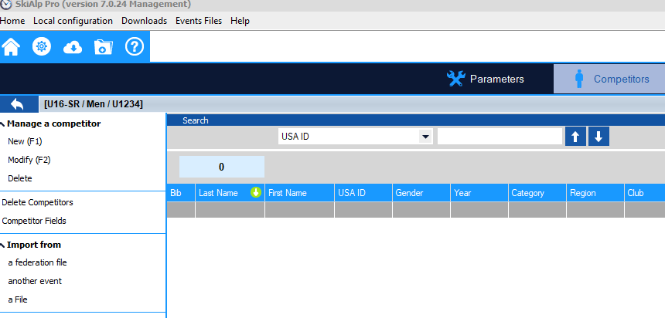
Importing Athletes via Excel
Choose: ‘Import from a File.’

Slide 35
Importing Athletes via Excel 1st way
Select file to import
Line up fields in the ‘Data Matching’ section.
Choose ‘Import’

Slide 36
Importing Athletes via Excel 2nd way= Paste
‘Copy’ fields needed from your open excel file
import competitors from a file
‘Paste’ and athletes populate in the ‘Data Matching’ window

Slide 37
Verify Import Numbers Match
110 in the excel, 110 imported into the race file

Slide 38
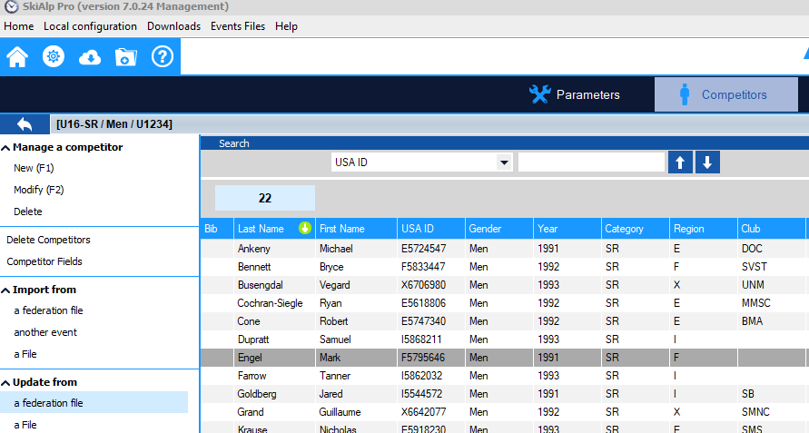
Updating Points After Excel Import
Choose
‘Update from a
Federation File.’
Choose OK on next screen

Slide 39
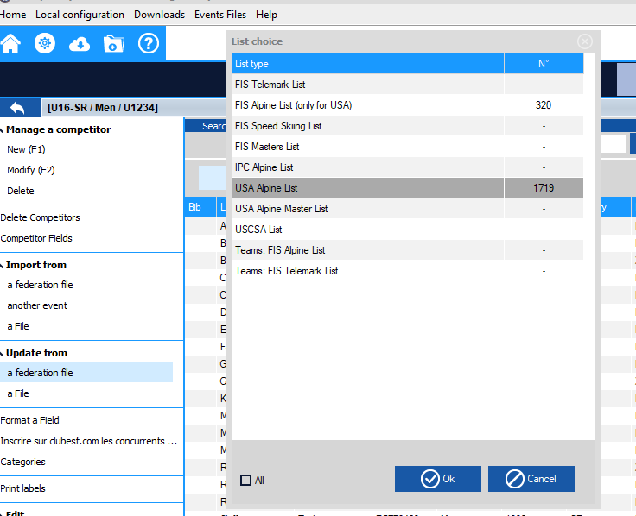
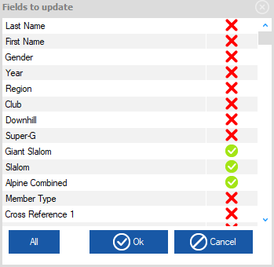
Updating Points
Select Update:
Select Source
Confirm event(s)
(Double Click to select or deselect update fields)
Click ‘OK’
Reminder: always verify points after import

Slide 40
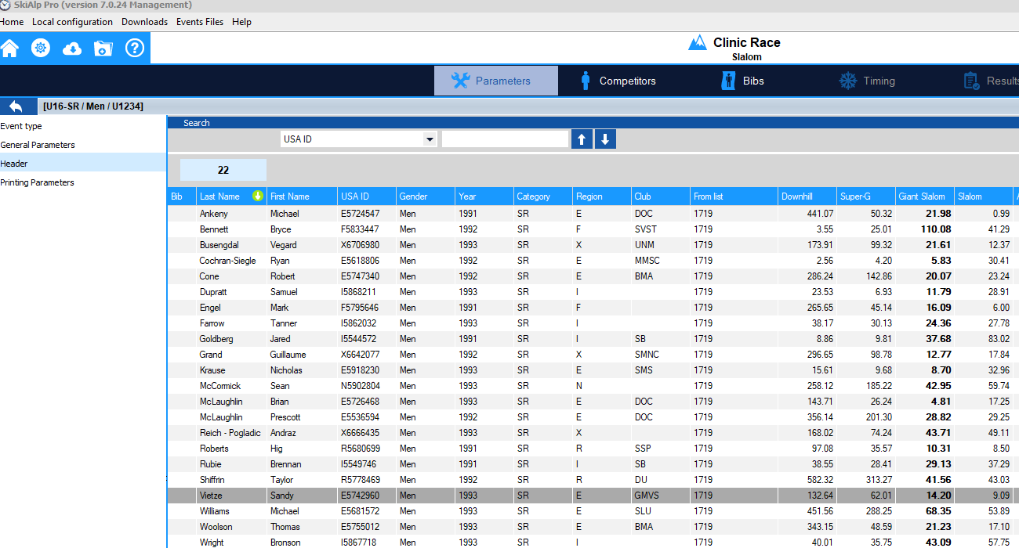
Quick Sort: Function can also be used in an Event File
Green arrow signals the column you are currently sorted by.
Double click on column header to change the sort .

Slide 41
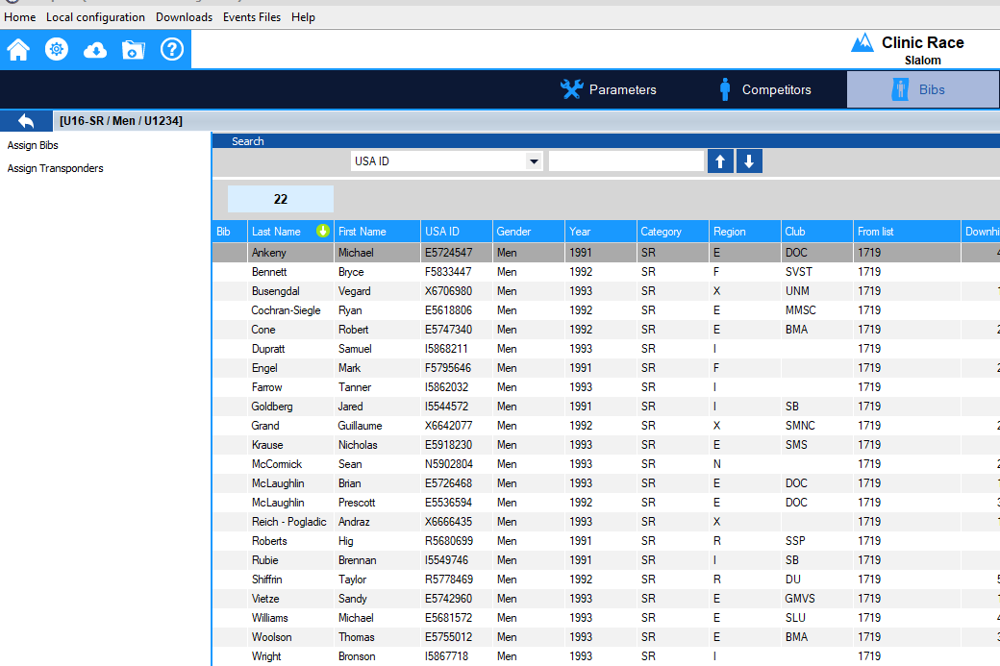
Assign Bibs
Select ‘Bibs’
Click on ‘Assign Bibs’

Slide 42
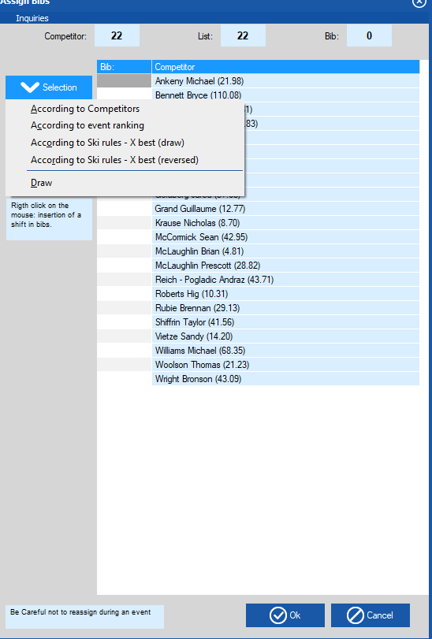
Draw and Assigning Bibs
According to Ski Rules – X Best(draw)
This will Randomize the top 15 and the 999.99

Slide 43
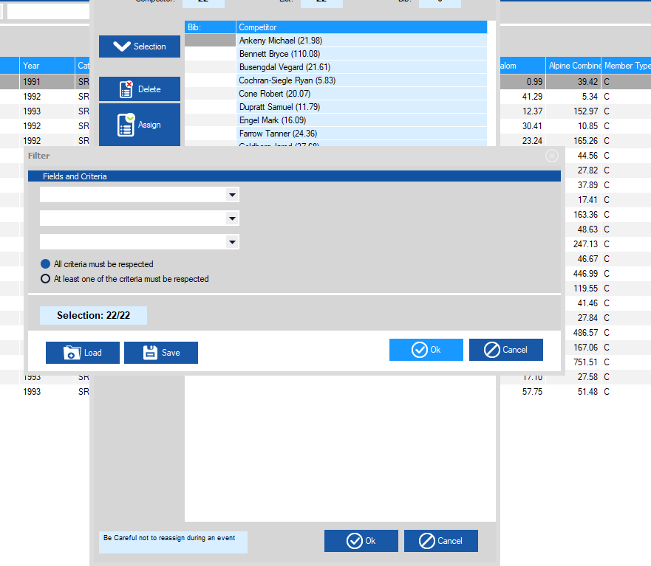
Draw and Assigning Bibs
No filter needed in a regular Scored Event Choose ‘OK’

Slide 44
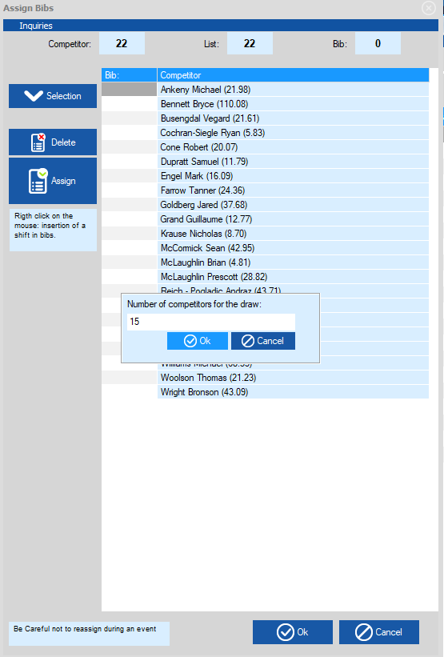
Draw and Assigning Bibs
Choose ‘Number of Competitors for Draw’
(Defaults to 15)
Choose ‘OK’ and randomization will occur. Scroll and Review accuracy of process.

Slide 45
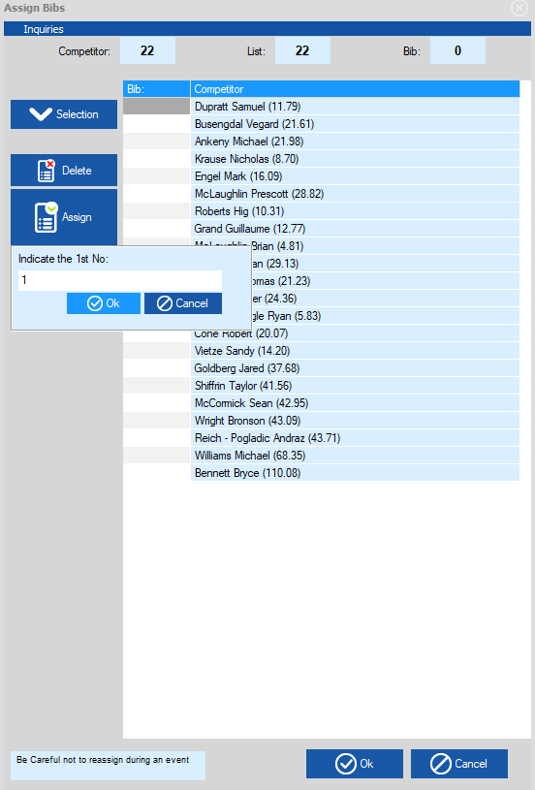
Draw and Assigning Bibs
Choose ‘Assign’ Enter starting bib number Choose ‘OK’
Click ‘OK’ again to load into the
‘ Competitors page’

Slide 46
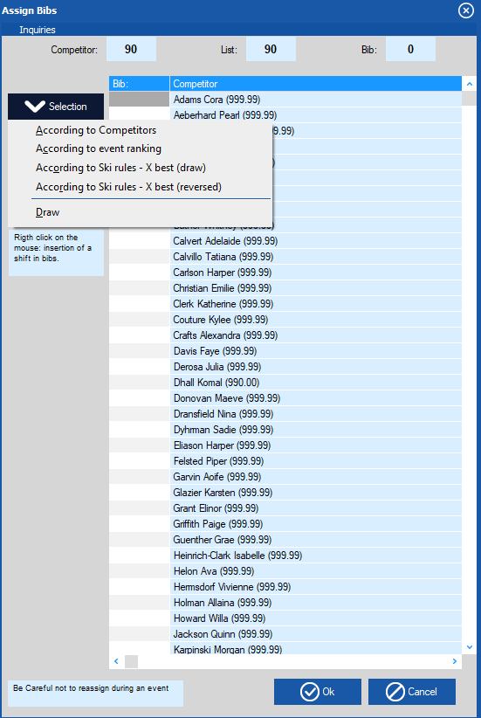
Draw and Assigning Bibs Non-Scored
Non-Scored Steps Assign Bibs Selection Draw

Slide 47
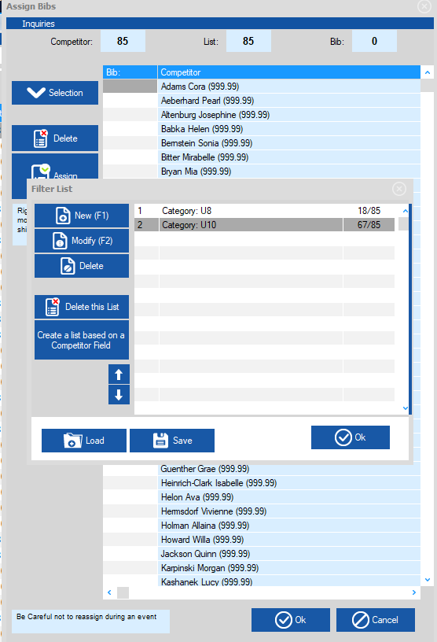
Draw and Assigning Bibs Non-Scored
Choose ‘OK’ on Filter List Window Random of the full field has taken place. Proceed to Assigning Bibs OR Apply a filter here and random will take place within each category

Slide 48
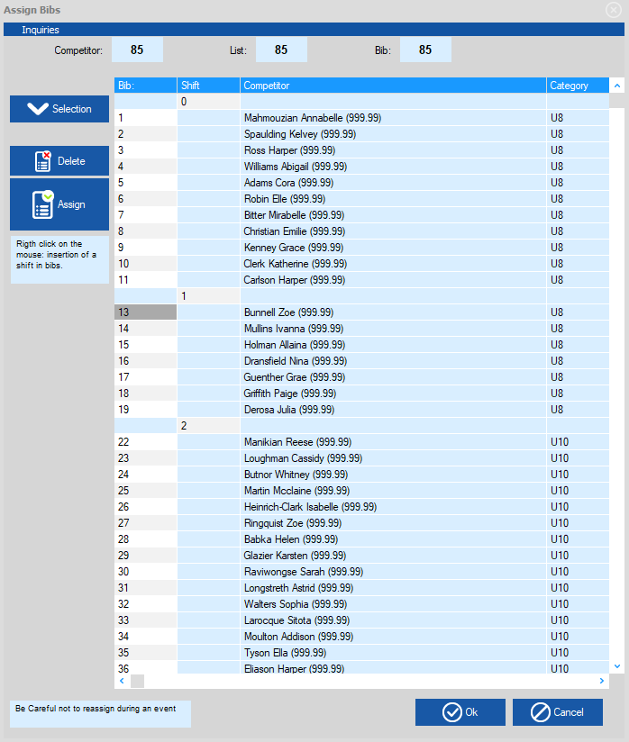
Missing bib – ‘shift in numbering’
When a bib is missing in the order: right click in the ‘shift’ column where you need to enter missing a bib. Enter # of bibs missing.

Slide 49
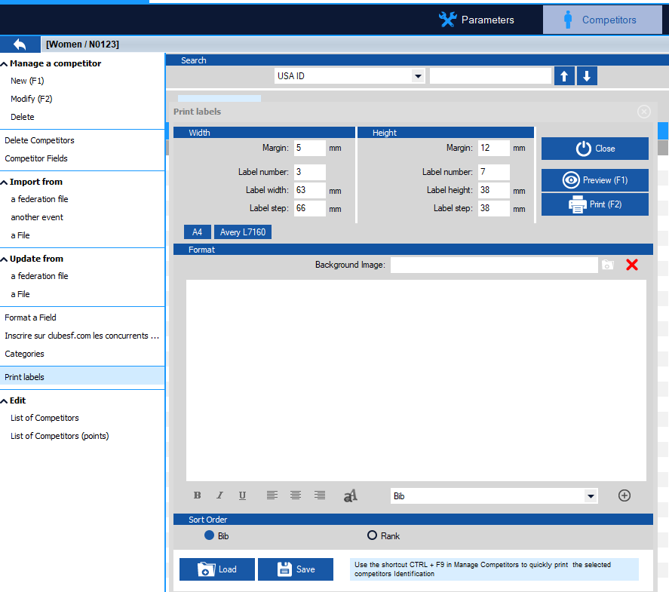
Seed Cards
In competitor screen, select ‘Print labels’. This screen allows you to create the set up for seed cards.

Slide 50
Creating a Start List
Choose ‘Timing’
Choose ‘Start List’
Make sure you are in Run 1

Slide 51
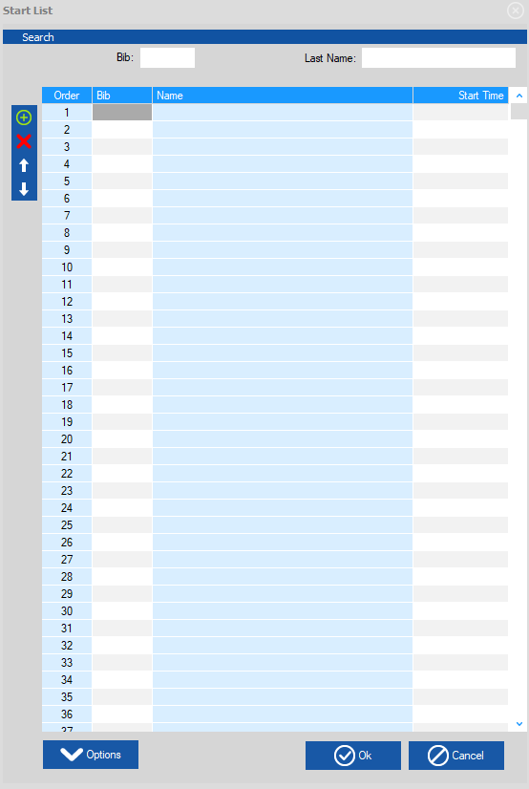
Creating a Start List
Choose ‘Options’
Choose ‘Prepare with Bibs’

Slide 52
Creating a Start List
Click on ‘Add’ to load the start list
Choose ‘Close’ to complete the task

Slide 53
Clearing a Start List
To get rid of this start list Click on
‘Delete this List’

Slide 54
Run(Print) a Start List
Make sure timing is selected
Choose ‘Run a Start List
Select Run 1
Select Ok

Slide 55
Run(Print) a Start List
From the ‘run start list’ box, you can create ‘custom’ start list and save the settings,
or click on ‘Preview’ to review and ‘Print’.

Slide 56
1st Run Start List

Slide 57
Condensed Start List
With or without the header
Choose 2 Columns

Slide 58
Snow Seed
Choose Start List
Choose Options
Choose Snow Seed from the list
Choose how many from last 20% are to be applied to the Snow Seed (rule is 6)
Choose ‘OK’

Slide 59
Snow Seed
Choose ‘Apply the Snow Seed’
To apply the Snow Seed
To un-apply the snow seed, uncheck the box

Slide 60
Snow Seed – Start List
Note Starred Athletes are drawn for the Snow Seed

Slide 61
Inserting a Late Racer/Entry Step 1
Click on
‘Start List’
Click on
the green
+ to add a line
Double click on the bib square to add bib #.
Please note there are multiple ways to enter a late athlete. This ppt addresses only one method.

Slide 62
Inserting a Late Racer/Entry Step 2
Return to ‘Competitors’ at the top of the page
Choose ‘Import from a federation file’ on the left of the page to open the ‘List Choice’ field

Slide 63
Inserting a Late Racer/Entry Step 3
Type in athlete
‘Last Name’
Double Clicking on the athlete will enter them into competitor list

Slide 64
Inserting a Late Racer/Entry Step 4
Double click on added athlete. Opens the ‘Modify’ box Add the assigned bib Add Nation and Club

Slide 65
Inserting a Late Racer/Entry Step 5
Return to ‘Timing’
Open ‘Start List’
Click above athlete, hold and drag to their start location

Slide 66
Timing Device
Choose Local Configuration
Timing Device 1
NOTE: Access to timing functions is limited if Hardware Protection Key (dongle) not correctly coded or updated.

Slide 67
Timing- Test Device
Select Timing Device
Test timing device

Slide 68
Timing Screen
Choose ‘Timing’
Click on ‘Timing’ to open the timing screen

Slide 69
Timing - Sync
Start List is loaded
Sync: Impulse to the Primary Time Base starts the clock in the software
Shows impulse received for sync

Slide 70
Timing
Unlock Start and Finish: Click on the green circle icon (green light), or double click on red dot to turn it green

Slide 71
Timing - Forerunners
Double click on bib 1 and Enter 901 as the first Forerunner.
This # can be changed under Options; Software Parameters, Forerunner numbers

Slide 72
Timing – Run in Progress
Double click green button to create the ‘unactive passage.’
Starts
Finishes
Records
Ranking Box
Double click on radio buttons to allow start and finishes to be ‘open’

Slide 73
Timing – Windows of Options
To select DNF, etc. -right click on athlete bib # to open the window of options and select

Slide 74
Timing – DNS
Highlight bib in Start Box Choose DNS Icon at top or right click and choose ‘status: Did not Start’

Slide 75
Timing – First Run Complete
Confirm Data

Slide 76
DSQ
Choose ‘Modify Data’
Type in bib
Status = Disqualified
Enter Gate # or Rule #

Slide 77
NPS
Choose ‘Modify Data’
Type in bib
Status = Not Permitted to Start
Enter Rule #

Slide 78
1st Run Results
Select Results at top of Page
Choose ‘Ranking After Run’ Choose ‘Run 1’ Click on ‘OK’ Preview or Print in the next screen

Slide 79
2nd Run Start List
Click on arrow to ‘Run 2’
Click on ‘Start List’ button
Click on ‘Options’ button
Choose ‘Prepare From Ranking of
Another Run’
This allows the option to include 1st run DNF and DSQ’s on the start list

Slide 80
Creating 2nd Run Start List
Insert ‘Bibbo’
Choose ‘Add’ Start list will load in background, Click on ‘Close’

Slide 81
Run(Print) 2nd Run Start List
Click on ‘Run Start List’ Choose ‘Run 2’
Click ‘OK’
The next step, printing/running of the start list, is the same process as run 1.

Slide 82
Results
Choose ‘Final Ranking’ to load overall results.
Final Ranking box will open, preview or print results.

Slide 83
Reading the Results
Jury
Weather Data
1st run Data
2nd run Data
Points list
Race Code
Software
version
Time and Date Report Printed

Slide 84
Transmitting Results - XML
On the Results page
Choose ‘Export Event’

Slide 85
Transmitting Results - XML
Where did my file save to?
Review For Errors
Attach xml file to email. Email results to ‘alpineresults@usskiandsnowboard.org’
U.S. Ski & Snowboard Transmittal # as the subject

Slide 86
Saving and Transferring File
Close event Choose ‘File’ Choose ‘Manage Events’ Choose ‘Save’ Choose the event to save

Slide 87
Saving and Transferring File
Name the Event Click on ‘Save’
Note file extension .spro and SkiAlpPro Default Folder location

Slide 88
Restoring a File
Choose ‘File’ Choose ‘Manage Events’ Choose ‘Restore an Event’ Select the correct .spro file, based on where you have saved this file.

Slide 89
Exporting Data
Click on ‘Export’ Choose ‘Copy for Excel’
Open an excel file and paste

Slide 90
SUGGESTIONS
Prior to your first event:
Review both sections of the Race Administration Study Guide
Review all software options
Practice all race-related software procedures
Establish contact with an experienced RA who will take the time to help you solve issues that may occur!

Slide 91
For further videos and educational items please review at
vola.fr/en/timing/logiciels/suite-skialp For assistance from U.S. Ski & Snowboard please visit:
usskiandsnowboard.org/sport-development/officials-development/timing-race-administration Thank you for your time and
best wishes on your upcoming season!

